Slide 1
AI CONSORTIUM INTERNSHIP 2nd June 2025 to 13th June 2025 Dynamic Price Prediction
Team No : 26
Arul Kaarthikeyan M – 2303917720521020
Harish Kumar P S – 2303917720521045
Mohamed Asfaq S – 2303917720521082
Prasanna T – 2303917720521107
Guide Name : Mrs. A. Indirani

Slide 2
Overview
Introduction
Problem Statement & Descriptions
Literature Review/Existing Solutions
Gap Identified
Objectives
Methodologies to solve the problem ( Design diagram and Steps)
Hardware and Software requirements
Dataset to be used
About Dataset
Implementation : Preprocessing output
Screenshot
Performance Comparison
Conclusion
Future work
Individual Contributions
References

Slide 3
Introduction
Online markets like Amazon are highly dynamic, and pricing a product correctly can make a big difference in sales.
Our project builds a system that uses competitor product data, Google search trends, and stock levels to recommend the best price for a product using machine learning.

Slide 4
Problem Statement & Description
Statement
Amazon sellers often struggle to price their products competitively due to changing market demand, competitor pricing, and stock conditions.
Manually adjusting prices is time-consuming and ineffective.
This project aims to build an ML-based pricing engine that suggests the best selling price to maximize profit without going below the cost.

Slide 5
Problem Statement & Description
Description
We collect data from Amazon and Google Trends, then use machine learning to relate competitor product features to their prices.
A time-series model (ARIMA) forecasts demand trends.
Based on the predicted base price, we apply simple rules considering trend score, stock level and product age to finalize a selling price.
This output helps Amazon sellers price smartly and profitably

Slide 6
Literature/Existing Solutions Review
Sl. No | Authors/ Affiliations | Title | Journal Name, Year | Observations
1 | Elsevier , Fabian Lange1, Rainer Schlosser | Dynamic Pricing with Waiting and Price-Anticipating Customers | Operations Research Perspectives, 2025 | Used PPO, SAC, DDPG in strategic settings. Considered buyer wait time and competitive behavior. Complex to implement in real-world environments.
2 | Management Science Journal | Dynamic Pricing and Inventory Management with Demand Learning | Management Science, 2020 | Bayesian demand learning with dynamic programming. Integrated inventory and pricing decisions but computationally expensive.

Slide 7
Literature/Existing Solutions Review
Sl. No | Authors/ Affiliations | Title | Journal Name, Year | Observations
3 | Andrii Prysizhnyk / Ukrainian Catholic University | Dynamic Pricing using Reinforcement Learning for the Amazon Marketplace | 2021 | Used Random Forest, Q-learning, DQN; demonstrated improved pricing accuracy. Faced memory issues with tabular Q-learning.
4 | Literature Survey / Ming Chen / Zhi-Long Chen | Recent Developments in Dynamic Pricing Research | Working Paper / Literature Survey, 2014 | Comprehensive survey covering multi-product and competition-driven pricing. Good theoretical depth but lacks empirical experiments or real data.

Slide 8
Literature/Existing Solutions Review
Sl. No | Authors/ Affiliations | Title | Journal Name, Year | Observations
5 | Chunli Yin, Jinglong Han | Dynamic Pricing Model Based on Consumer Behavior Analysis | CMES: Computer Modeling in Engineering & Sciences, 2020 | Focused on consumer behavior, sensitivity, and value perception. The model lacks integration with competitor pricing or live data.

Slide 9
Gap Identified
Most models only consider one or two factors like demand or competitor pricing.
Real-world pricing depends on many changing things at once—stock, age, trends, competitors.
There’s no existing solution that combines all of these live data sources in real time-this project does.

Slide 10
Objectives
Scrape competitor data (price, rating, reviews) from Amazon.
Use Google Trends to forecast product demand.
Predict a base price using XGBoost.
Adjust price based on trend score ,stock age and availability.
Recommend a final price that stays above cost and maximizes profit.

Slide 11
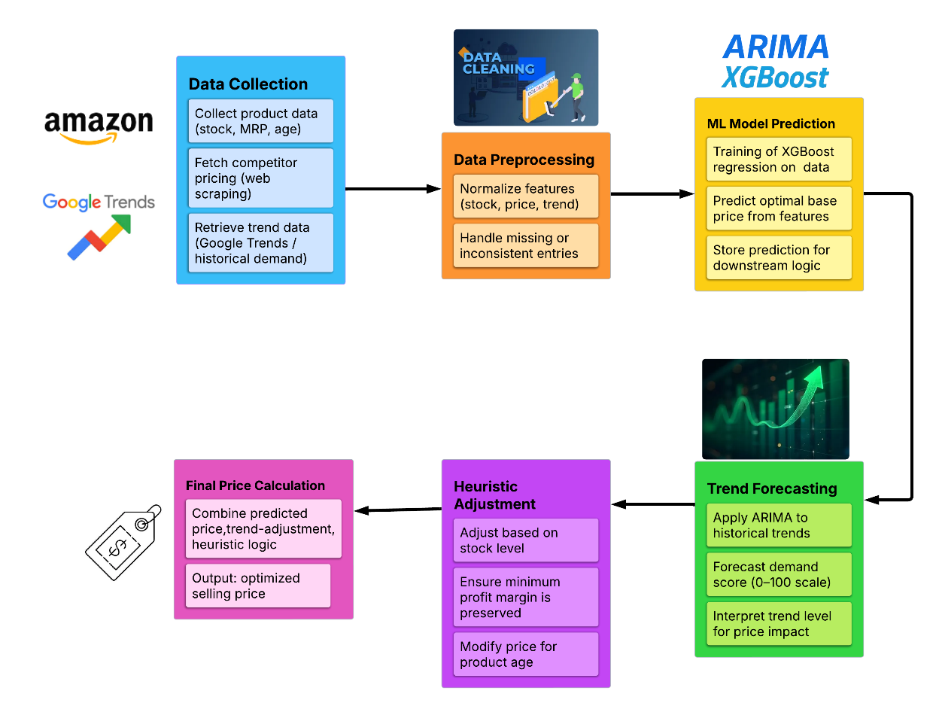
Methodology Diagram

Slide 12
Methodology Steps
Data Collection
Product Info: Collect key attributes like stock quantity, MRP, and age of product.
Competitor Pricing: Use web scraping to fetch prices, ratings, and reviews from Amazon.
Trend Signals: Query Google Trends to get demand scores and historical search volume.
Data Preprocessing
Normalize Data: Standardize stock, price, and trend scores for machine learning input.
Handle Issues: Clean missing or inconsistent data entries for smooth model training.

Slide 13
Methodology Steps
ML Model Prediction
Model: Train an XGBoost regression model on cleaned dataset.
Output: Predict a base price using input features like stock, trend, and competitor data.
Store Results: This base price is saved and passed to the next logic layers.
Trend Forecasting
Model: Use ARIMA to forecast demand trends based on Google Trends data.
Demand Score: Predict future interest (0–100 scale) for the product.
Influence: Use this score to estimate upward/downward pricing potential.

Slide 14
Methodology Steps
Heuristic Adjustment
Stock Level Logic: Lower stock may increase price; excess stock may reduce it.
Age Logic: Older products may get discounted; newer items may retain value.
Margin Logic: Ensures final price never goes below cost + minimum profit.
Final Price Calculation
Combine Factors: Merge ML base price + demand forecast + manual heuristics.
Output: Optimized price suggestion that balances demand, profit, and market competitiveness.
Reflects real-time demand and competitor context.
Ensures profit above cost.

Slide 15
Hardware and Software Requirements
Hardware Requirements :
Processor: Intel Core i5 or above
RAM: Minimum 8 GB
Storage: 500 MB for datasets and reports
Network: Stable internet connection (for scraping & trend data)
Software Requirements :
Operating System: Windows 10 / Ubuntu 20.04
Programming Language: Python 3.8+
Libraries/Frameworks: Flask (Web framework), BeautifulSoup (Web scraping), XGBoost (ML model), statsmodels (ARIMA for time-series forecasting) , pytrends (Google Trends API), pandas, numpy, scikit-learn, requests

Slide 16
Dataset to be used
Identified Dataset
Amazon Product details (Web Scraping) - https://www.amazon.in/
Google Trends (Pytrends ) https://trends.google.com/trends/

Slide 17
About Dataset
Amazon Dataset :
Collected using custom scraper (BeautifulSoup).
Attributes: Product title, price, rating, review count, monthly sales.
Samples: Avg. ~80 products per category scraped (up to 3 pages).
Google Trends :
Daily interest score over 90 days.
Attributes: Date, interest score (0–100).
Format: Time-series data for ARIMA forecasting.

Slide 18
Implementation : Preprocessing Output
Steps Performed :
Removed products with missing/zero reviews or sales
Filtered out price outliers.
Applied log transformation on price, reviews, sales
Normalized trend scores
Fused ARIMA-predicted trend into feature set

Slide 19
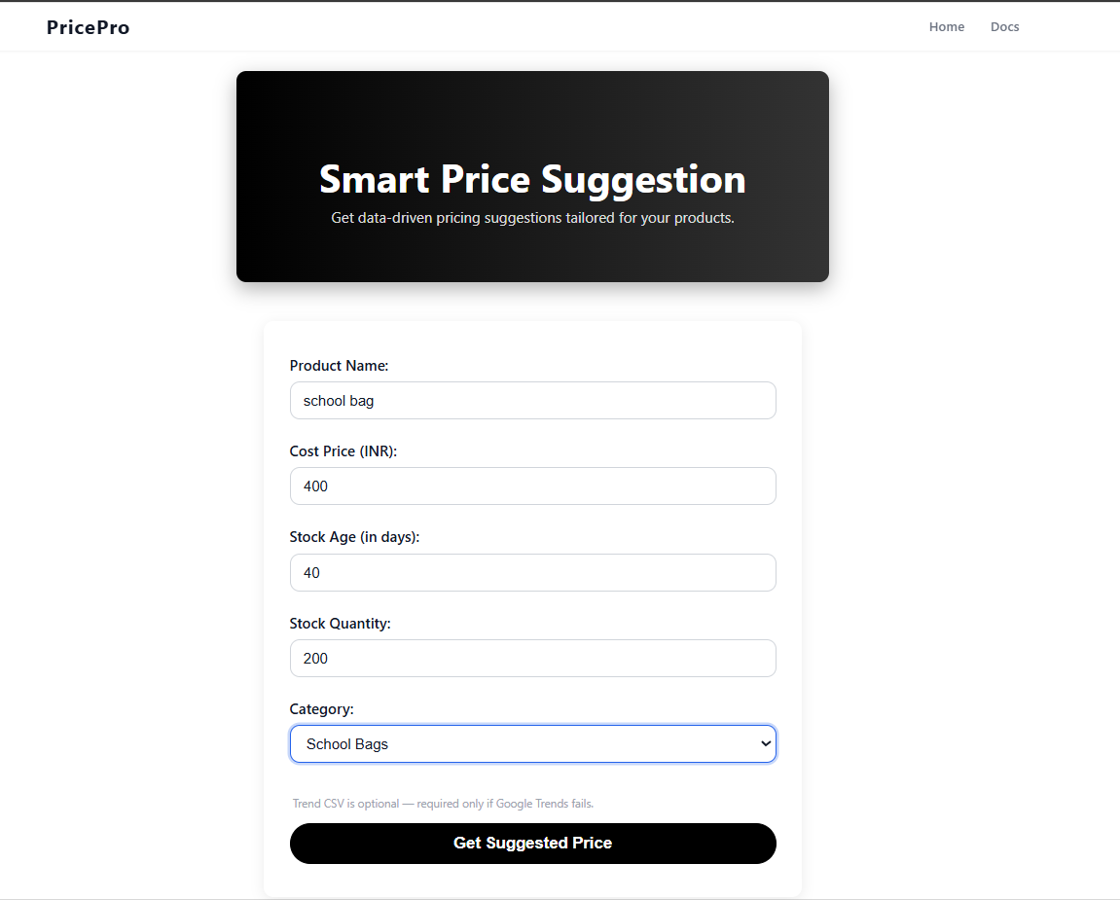
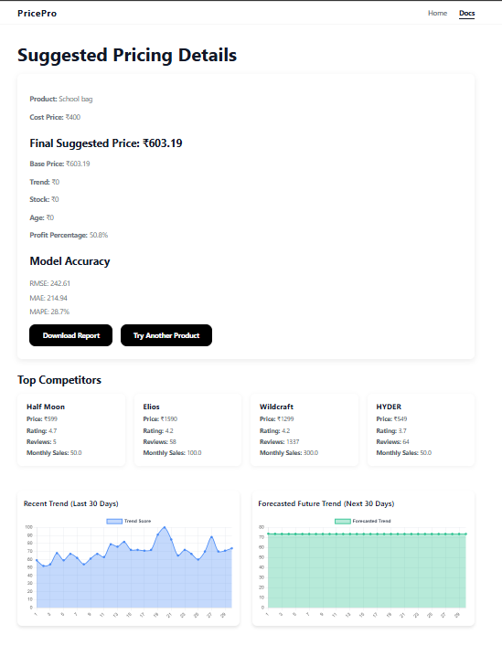
Screenshot
Input Page
Result Page

Slide 20
Performance Comparison
Feature Source | Model | RMSE (₹) | MAE(₹) | MAPE(%)
ARIMA | XGBOOST | 348.20 | 325.07 | 22.14
LSTM | LightBGM | 607.39 | 411.80 | 46.95
 | Bayesian Ridge | 487.12 | 344.80 | 38.73
 | XGBOOST | 399.65 | 298.0 | 32.76
Prophet | LightBGM | 590.74 | 584.67 | 57.32
 | Bayesian Ridge | 590.74 | 584.67 | 57.32
 | XGBOOST | 414.98 | 302.67 | 20.82
Sample Comparison for Product “ Wireless Mouse”
XGBoost for learning from product features (ratings, reviews, sales),
ARIMA for demand trend forecasting from Google Trends data.
This hybrid model achieved : RMSE: ₹348.20 , MAE: ₹325.07, MAPE: 22.14%

Slide 21
Conclusion
Scrapes live competitor data from Amazon
Uses ARIMA to forecast trend signals from Google Trends
Predicts base price using XGBoost
Applies heuristic adjustments for real-world business logic
Provides optimized prices that ensure profitability while responding to market trends

Slide 22
Future Work
Integrate additional market data sources like Flipkart or Snapdeal for a broader competitor landscape.
Replace ARIMA with Prophet or LSTM models for better demand trend forecasting accuracy on non-linear time-series data.
Incorporate seasonality detection (festivals, sale periods) to adjust price multipliers dynamically.
Add user authentication, history tracking, and price recommendation logs for improved dashboard features and analytics.

Slide 23
Individual contribution
Arul Kaarthikeyan M – Feature engineering, heuristic adjustment logic
Mohamed Asfaq S – Amazon web scraper for competitor data
Harish Kumar P S – XGBoost training, ARIMA integration, performance tuning
Prasanna T – Backend system, final price logic, UI integration, documentation

Slide 24
References
Google Trends Documentation : https://trends.google.com/
Dynamic Pricing Algorithm Overview : https://research.aimultiple.com/dynamic-pricing-algorithm/
Dynamic Pricing Using ML : https://medium.com/@baabak/dynamic-pricing-using-machine-learning-5e882282effe
Scraping Amazon Product Information Using Beautiful Soup: https://www.geeksforgeeks.org/scraping-amazon-product-information-using-beautiful-soup/

